Slide 1

Analysing the correlation of symmetrical sudokus with their solving time using SAT solvers
Ruben Blom – 10684980
Luca Simonetto - 11413522

Slide 2
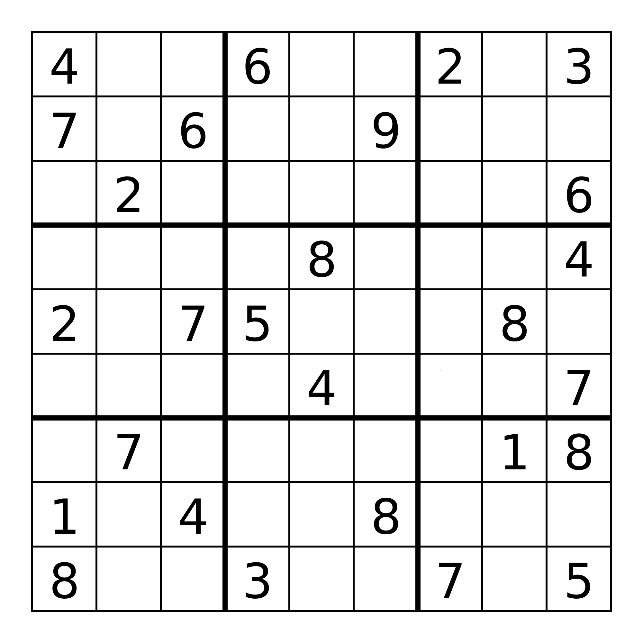
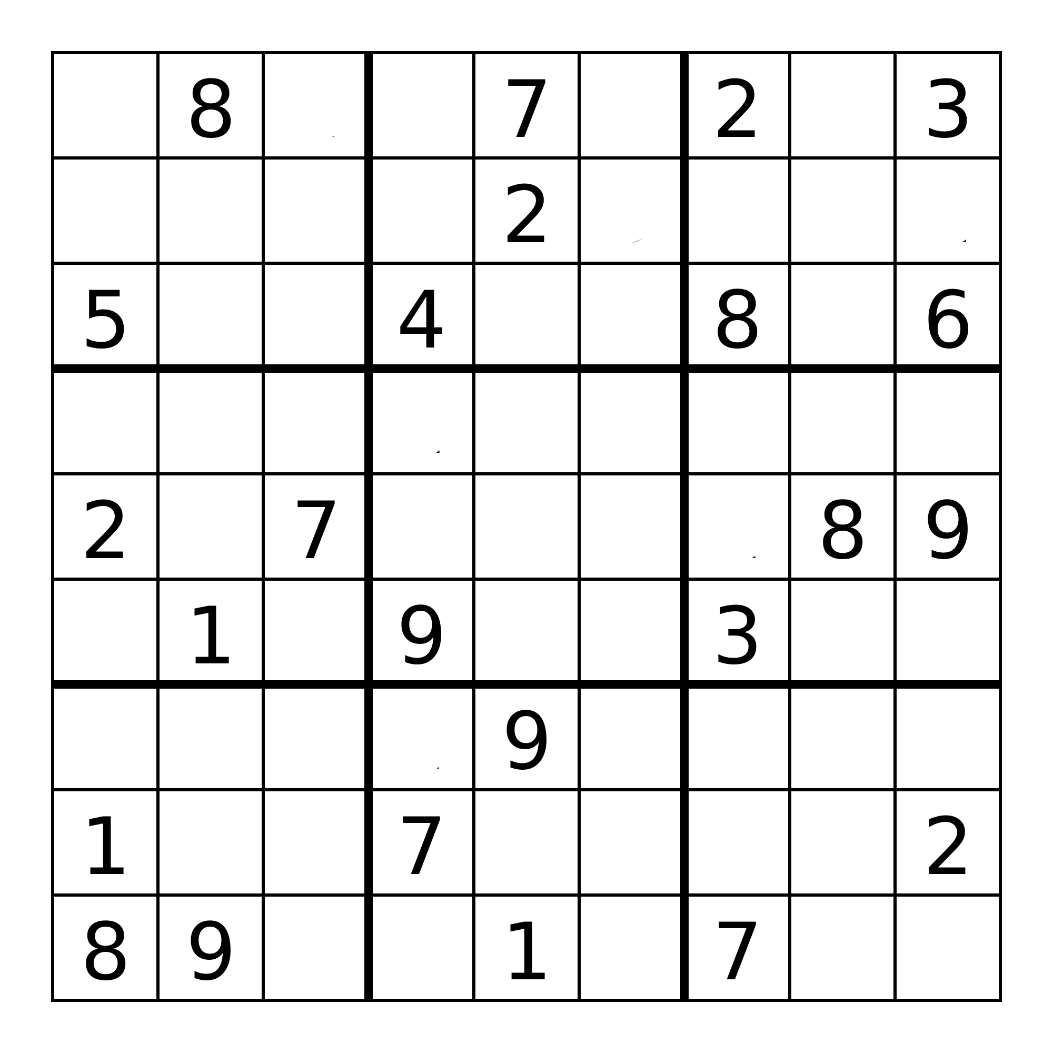
Symmetry in sudokus
The position of each given on the board is mirrored by another one.
Horizontal (and vertical)
Diagonal (and anti diagonal)
Pi rotational
Horizontal and vertical
Diagonals

Slide 3
Hypothesis
Will the symmetry property of a sudoku puzzle affect the time required for a computer to solve it?

Slide 4
Dataset
Datasets with symmetrical sudokus are very rare or non existent
Each symmetry has to contain a reasonable number of sudokus
All sudokus have to be labeled by difficulty
We created our own dataset with a custom generator

Slide 5
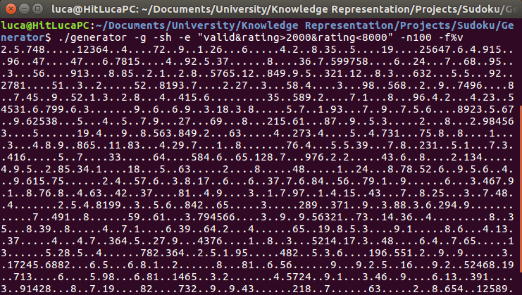
Generator
Created by Glenn Fowler
./generator -g -sS -e "E" -nN -f%v -o O
-g generate sudokus
-sS use S as symmetry (h, v, d, p, etc. for symmetries)
-e “E” use E as generating expression (valid&rating>x&rating<y)
-n N generate N sudokus
-f%v remove unnecessary output
-o O output in file O
huge amount of time needed to
generate the datasets!

Slide 6
Difficulties
The generator has a difficulty rating ranging from 0 to 9999.
We created five ranges in order to divide the dataset in five difficulties
Difficulty | Range
Easy | 0-2000
Medium | 2001-4000
Hard | 4001-6000
Very hard | 6001-8000
Extreme | 8001-9999

Slide 7

SAT solver
We chose PycoSat, Python wrapper of PicoSat
Deterministic
Python ready
Easy to use

Slide 8
Metric
The chosen metric is ELAPSED TIME
Why?
Well fits our needs
Easy to implement
No need to reverse engineer PycoSat to get data
Problems
Prone to misreading due to other running processes
Fast computers may get reading that are too small to be precise and comparable
Solution use CPU time instead
Hardware independent
Pure reading
Less susceptible to other processes

Slide 9
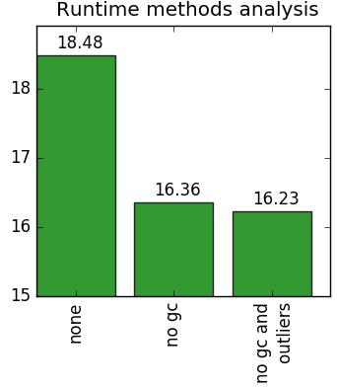
Metric
The garbage collector has been disabled when waiting for a solution from the SAT solver.
Why?
If the garbage collector is executed when running the SAT solver, the elapsed times increases by 12%!

Slide 10
Experimental Procedure
Run the SAT solver across each dataset N times
After each run, remove the two sudoku outliers (short processes influence)
After N runs, remove the two run outliers (medium processes influence)
Compute mean and variance

Slide 11
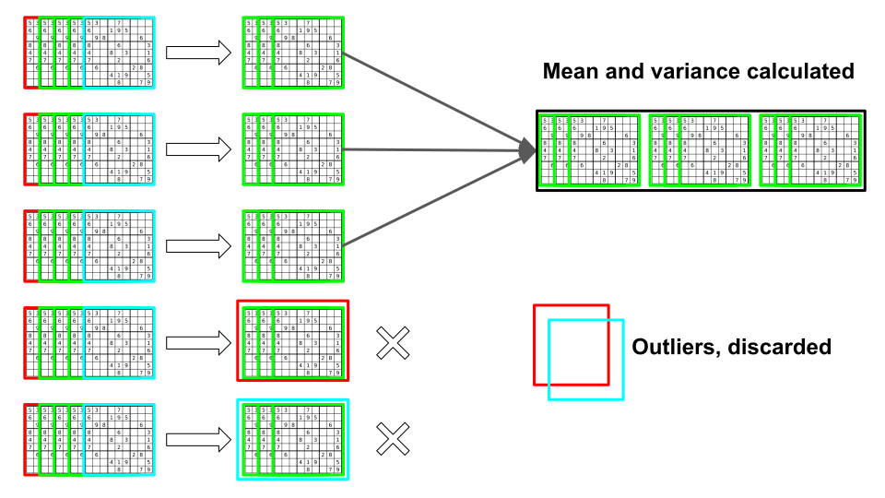
Experimental Procedure

Slide 12
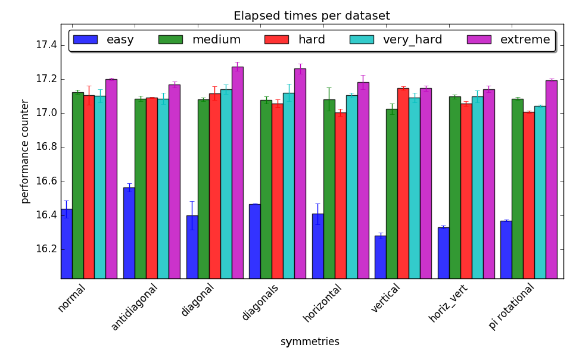
Experimental results

Slide 13
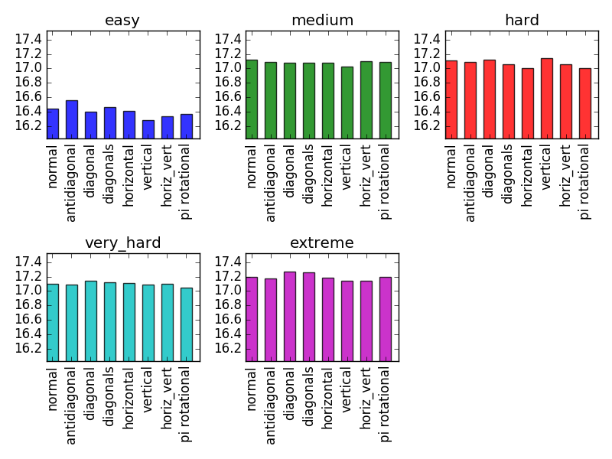
Experimental results

Slide 14
Experimental results
The hypothesis is considered falsified
Easy sudokus take a noticeably lower time to be solved
Visible differences are too small to be significant (around 0.3 milliseconds maximum)
The variance in the results is very marginal (every time under 0.1)

Slide 15
Future work
Use different metrics
Compare different SAT solvers
Use different techniques
...

Slide 16
Thank you!

